Slide 1
Microsoft Power BI

Slide 2


Developing Power BI for Dataverse + PowerApps, and Dynamics 365
Scott Sewell Principal Program Manager Power BI CAT team
/in/mscottsewell
@ScottSewell

Slide 3
Demo
Power BI in a Model-Driven Power App
Connecting Power BI to Dataverse
Connectivity Options
Dataverse Direct Query Tips

Slide 4
Fast Facts on Connectivity between Power BI and Dataverse
More Flexibility / More Value

Slide 5
Dataverse to Power BI Decision Support
Dataverse Direct Query
Dataverse Import Mode
Azure Data Lake + Synapse
Basic Options
Report Categories
Report User Personas
Security Implications
Performance Impacts
Data Volume

Slide 6
Dataverse to Power BI Decision Support
Dataverse Direct Query
Individual user’s own data – near real-time refresh
Targeted datasets pulled from enormous databases
Dataverse Import Mode
Scheduled refreshes of medium-sized datasets
Azure Data Lake + Synapse
Enterprise-Scale data source for reporting
Basic Options
Report Categories
Report User Personas
Security Implications
Performance Impacts
Data Volume

Slide 7
Dataverse to Power BI Decision Support
Operational users
Dataverse Direct Query
Groups, or Users with wide visibility
Dataverse Import Mode
Enterprise level complexity
Azure Data Lake + Synapse
Basic Options
Report Categories
Report User Personas
Security Implications
Performance Impacts
Data Volume

Slide 8
Dataverse to Power BI Decision Support
Trimmed with Dataverse Security
Dataverse Direct Query
Security handled Outside Dataverse
Dataverse Import Mode
Azure Data Lake + Synapse
Basic Options
Report Categories
Report User Personas
Security Implications
Performance Impacts
Data Volume

Slide 9
Dataverse to Power BI Decision Support
Refreshed on-demand
Dataverse Direct Query
Highly Responsive Report UX
Dataverse Import Mode
Azure Data Lake + Synapse
Basic Options
Report Categories
Report User Personas
Security Implications
Performance Impacts
Data Volume

Slide 10
Dataverse to Power BI Decision Support
Under ~100K records* in result set
Dataverse Direct Query
Dataverse Import Mode
A few hundred thousand records*
Power BI Premium with Incremental Refresh
Larger datasets
Azure Data Lake + Synapse
Basic Options
Report Categories
Report User Personas
Security Implications
Performance Impacts
Data Volume
*There is an 80-MB maximum size & a 2-minute timeout for individual query results returned from the Dataverse TDS/SQL endpoint.

Slide 11
Best practices for Direct Query of Dataverse in Power BI

Slide 12

Direct Query Hints
Stay focused on use case
Embrace a Star Schema
Minimize query columns
Leverage the Query Editor
Avoid large blocks of text
Minimize optionset labels
Consider dual-mode dims
Don’t forget the checkbox
More information:
What topic area is this report supporting?
Who is the audience of this report?
What question is the report trying to answer?
What’s the MVD - Minimum Viable Dataset?

Slide 13


Direct Query Hints
Stay focused on use case
Embrace a Star Schema
Minimize query columns
Leverage the Query Editor
Avoid large blocks of text
Minimize optionset labels
Consider dual-mode dims
Don’t forget the checkbox
More information:

Slide 14
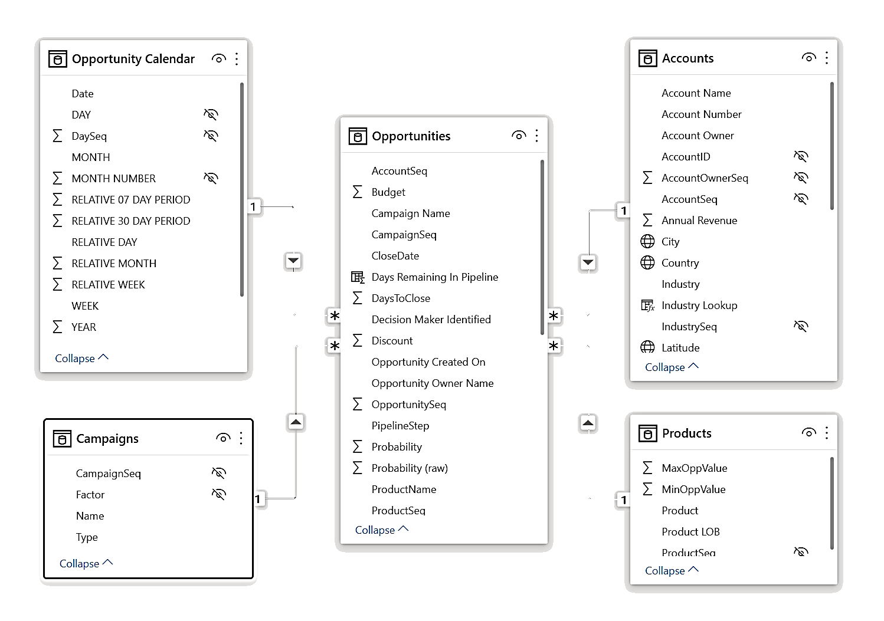





Direct Query Hints
Stay focused on use case
Embrace a Star Schema
Minimize query columns
Leverage the Query Editor
Avoid large blocks of text
Minimize optionset labels
Consider dual-mode dims
Don’t forget the checkbox
More information:
Dimension
Dimension
FACT
Dimension
Dimension
Understand star schema and the importance for Power BI - Power BI | Microsoft Docs

Slide 15
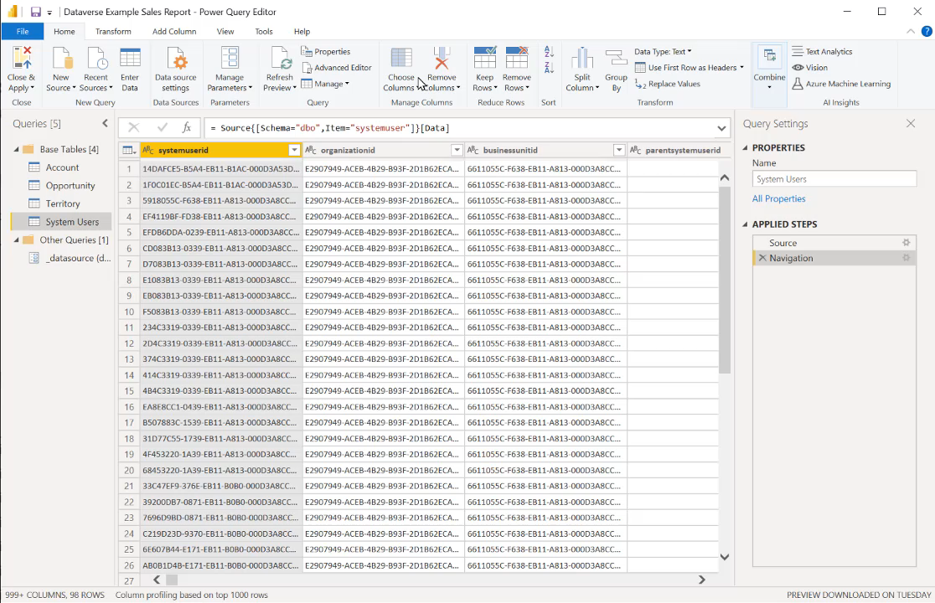
Direct Query Hints
Stay focused on use case
Embrace a Star Schema
Minimize query columns
Leverage the Query Editor
Avoid large blocks of text
Minimize optionset labels
Consider dual-mode dims
Don’t forget the checkbox
More information:
Laura-GB/DataversePowerQueryHelper: Tools built using Excel VBA to help build Power Query code to access a Dataverse environment (github.com)

Slide 16
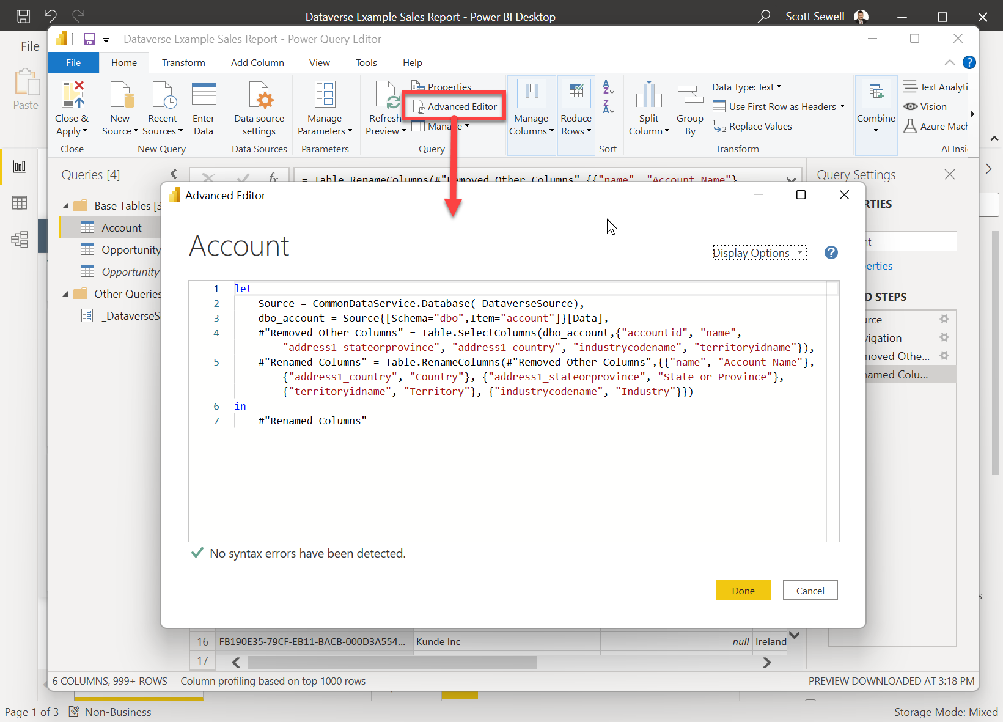
Direct Query Hints
Stay focused on use case
Embrace a Star Schema
Minimize query columns
Leverage the Query Editor
Avoid large blocks of text
Minimize optionset labels
Consider dual-mode dims
Don’t forget the checkbox
More information:
With large tables, build the query in the Query Editor. A simple query will get you started and allow you to build up the query quickly and ‘safely’. let
Source = CommonDataService.Database("dataverseadl.crm.dynamics.com"),
dbo_account = Source{[Schema="dbo",Item="account"]}[Data],
#"Removed Other Columns" = Table.SelectColumns(dbo_account,{"accountid", "name"})
in
#"Removed Other Columns"

Slide 17
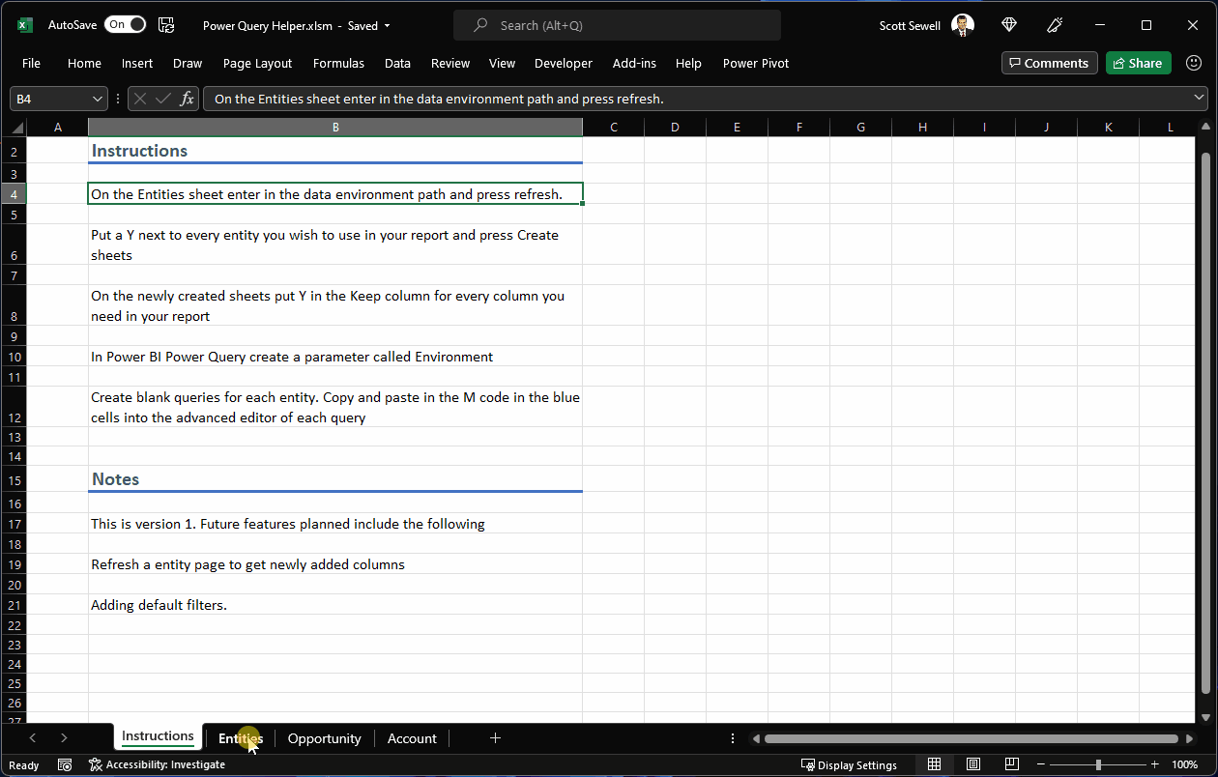
Direct Query Hints
Bonus: Excel tool for Building Power Queries on Dataverse by: Laura Graham-Brown (@Laura_GB)
https://github.com/Laura-GB/DataversePowerQueryHelper
Stay focused on use case
Embrace a Star Schema
Minimize query columns
Leverage the Query Editor
Avoid large blocks of text
Minimize optionset labels
Consider dual-mode dims
Don’t forget the checkbox
More information:

Slide 18
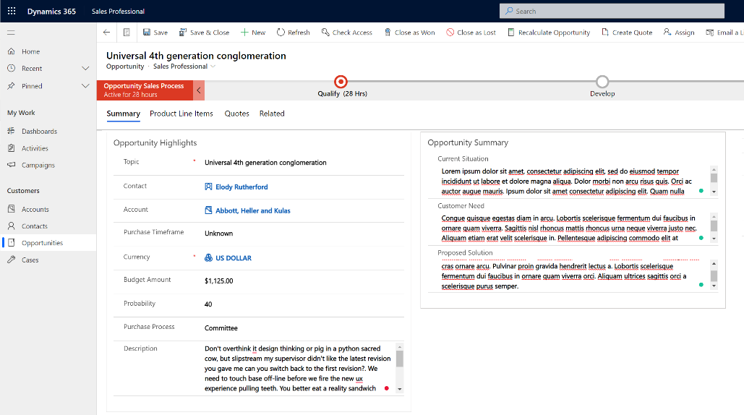


Direct Query Hints
Stay focused on use case
Embrace a Star Schema
Minimize query columns
Leverage the Query Editor
Avoid large blocks of text
Minimize optionset labels
Consider dual-mode dims
Don’t forget the checkbox
More information:

Slide 19
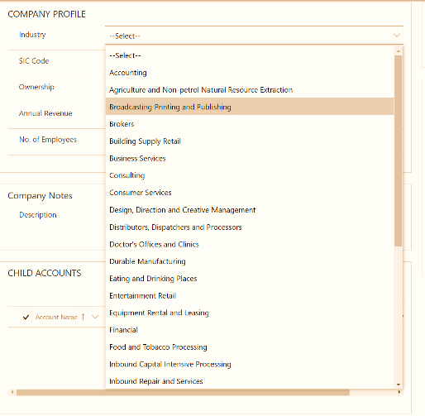

Direct Query Hints
Stay focused on use case
Embrace a Star Schema
Minimize query columns
Leverage the Query Editor
Avoid large blocks of text
Minimize optionset labels
Consider dual-mode dims
Don’t forget the checkbox
More information:
Whenever possible, filter the dataset on the numeric value of an optionset, rather than the string.
Normally a few optionsets are fine, but if there are a dozen or more being pulled in the query, consider returning only the integer value from Dataverse and using a calculated field to apply the label inside Power BI. – This improves speed and reduces the overall size of the query results.

Slide 20
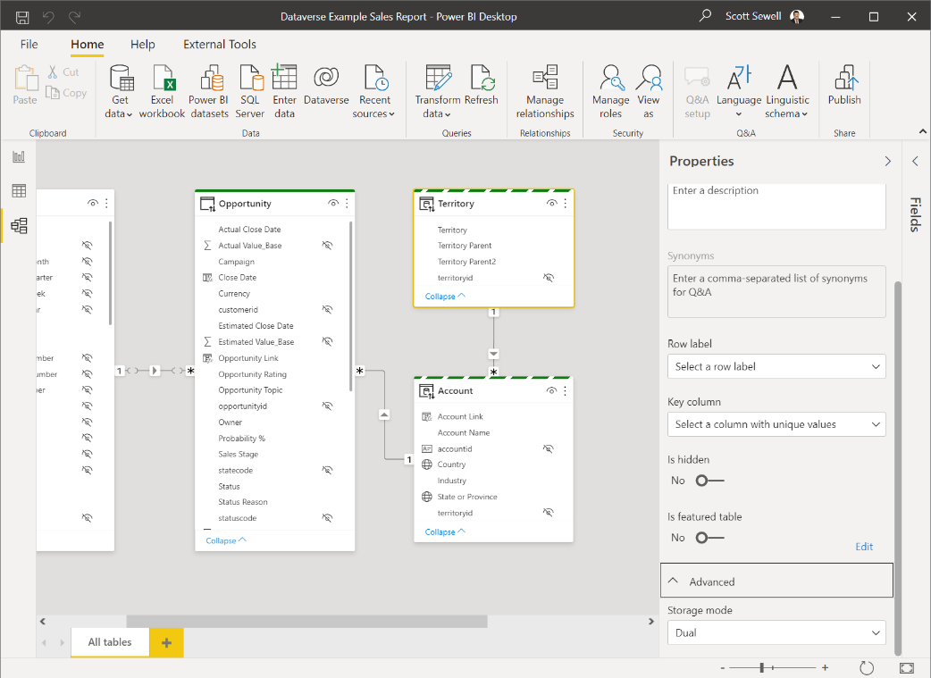
Direct Query Hints
Stay focused on use case
Embrace a Star Schema
Minimize query columns
Leverage the Query Editor
Avoid large blocks of text
Minimize optionset labels
Consider dual-mode dims
Don’t forget the checkbox
More information:

Slide 21
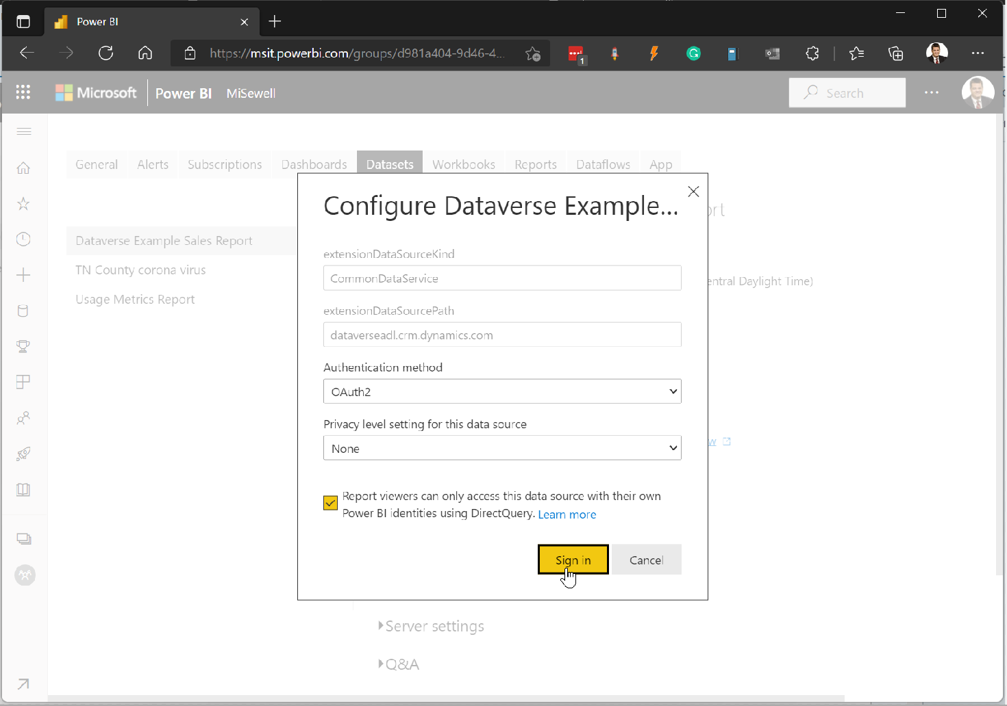
Direct Query Hints
Stay focused on use case
Embrace a Star Schema
Minimize query columns
Leverage the Query Editor
Avoid large blocks of text
Minimize optionset labels
Consider dual-mode dims
Don’t forget the checkbox
More information:
After Publishing the Report, you’ll need to set up the credentials for the dataset.
Be sure to click the checkbox to ensure report viewers will see the report filtered to the data they have permission to see within Dataverse.

Slide 22
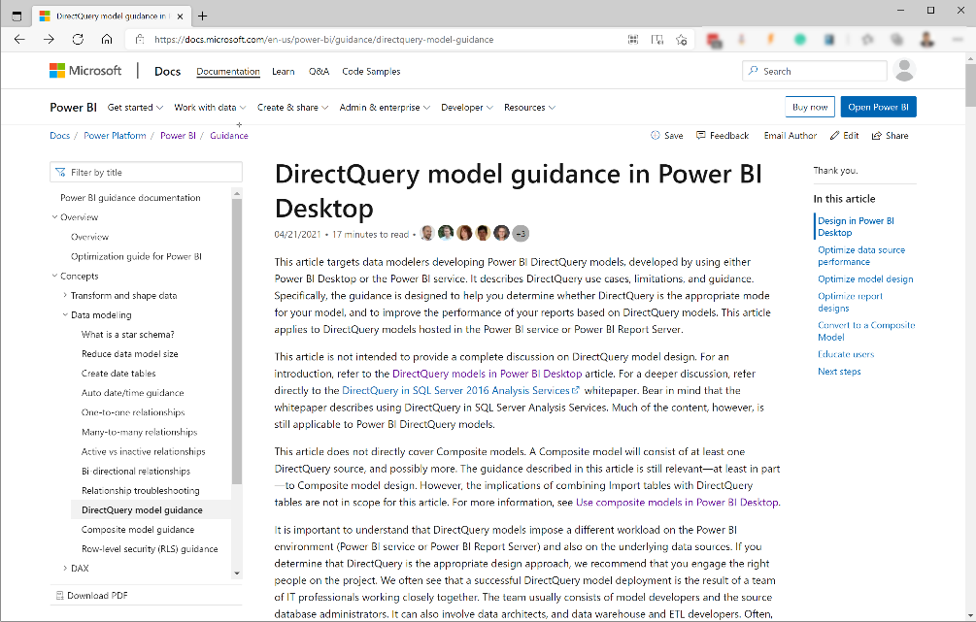
Direct Query Hints
Stay focused on use case
Embrace a Star Schema
Minimize query columns
Leverage the Query Editor
Avoid large blocks of text
Minimize optionset labels
Consider dual-mode dims
Don’t forget the checkbox
More information:
DirectQuery model guidance in Power BI Desktop - Power BI | Microsoft Docs
DirectQuery model troubleshooting in Power BI Desktop - Power BI | Microsoft Docs

Slide 23
Resources
Power BI guidance documentation

Slide 24
Thank You!

